Slide 1

Introduction to the drift diffusion model
Blair R K Shevlin

Slide 2
Introduction to the diffusion decision model
Blair R K Shevlin

Slide 3
who am I?
Blair Shevlin, PhD
PhD in Decision Psychology [The Ohio State University]
Mentors: Ian Krajbich, Roger Ratcliff
Focus: economic decisions; sequential sampling models
Postdoc in Computational Psychiatry [Mount Sinai]
Mentors: Laura Berner, Xiaosi Gu
Focus: compulsive-use disorders; human voltammetry

Slide 4
Acknowledgments
Kianté Fernandez (UCLA)
Ian Krajbich (UCLA)
Laura Fontanesi (Basel)
Robert (Bob) Wilson (Arizona, Georgia Tech)

Slide 5
Goals
Describe the background behind the development of the diffusion decision model
Explain the intuitions behind the diffusion decision model
Describe the application of the diffusion decision model to value-based choice
Demonstrate the practical implementation of the diffusion decision model

Slide 6
3-2-1 Exercise
For three minutes, list the following about modeling the decision-making process:
3 things you know
2 things you would like to know
1 question you have

Slide 7
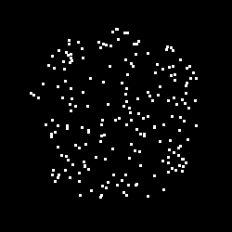
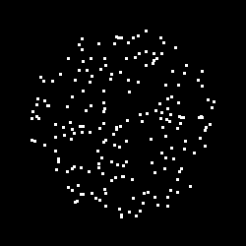
how to understand the decision-making process?
which way are the dots moving?

Slide 8
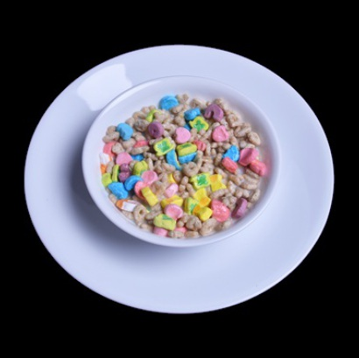
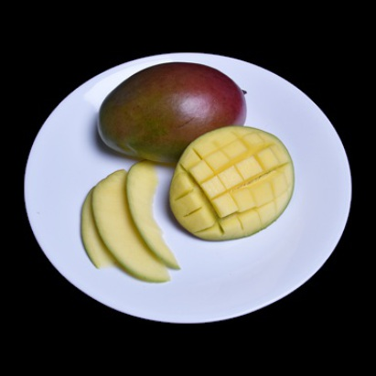
how to understand the decision-making process?
which food should I choose?

Slide 9
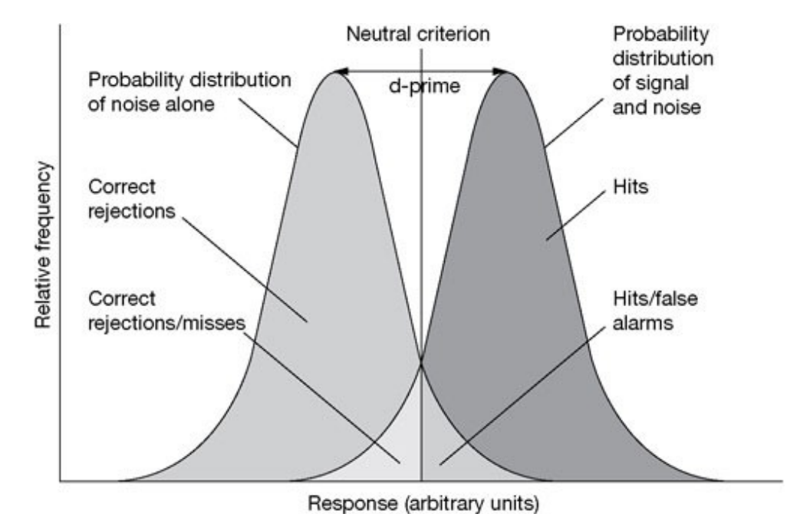
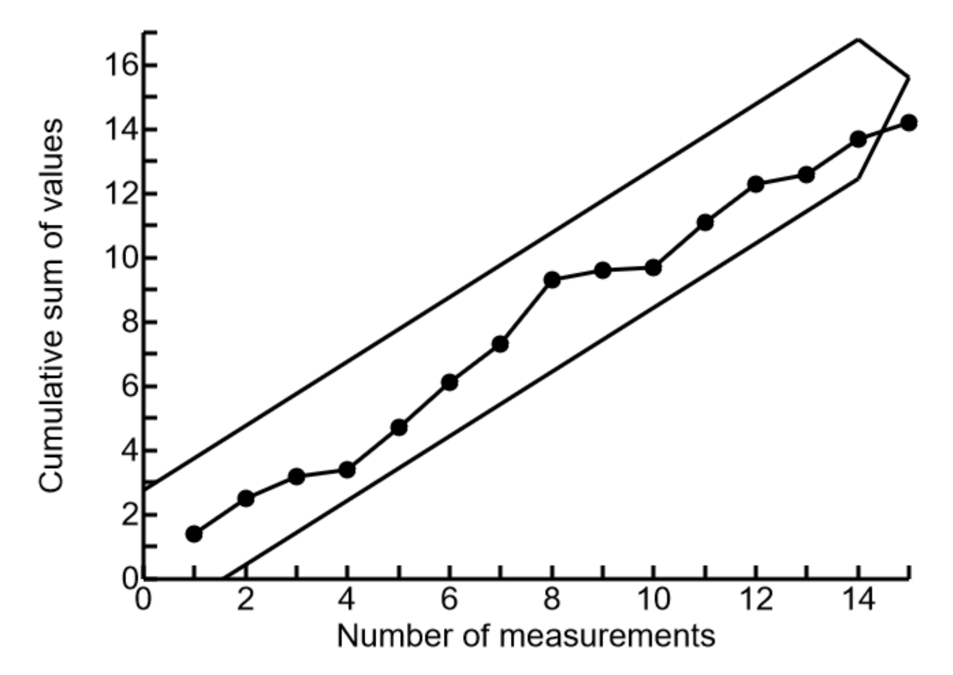
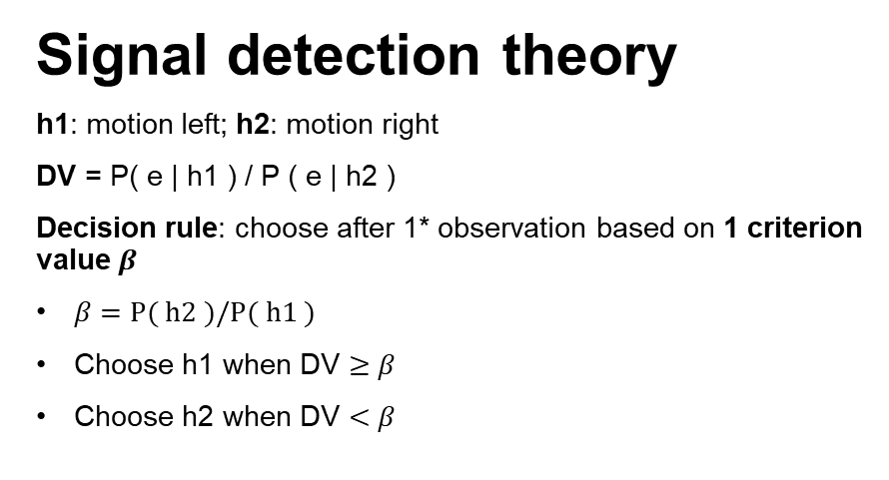
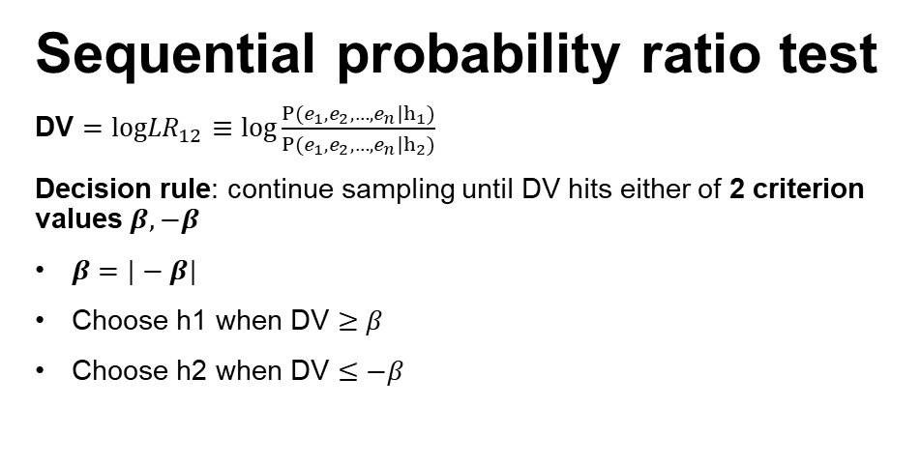
history
reject null hypothesis
accept null hypothesis
Signal detection theory
h1: motion left; h2: motion right
DV = P( e | h1 ) / P ( e | h2 )
Decision rule: choose after 1* observation based on 1 criterion value $β$
$β=P( h2 )/P( h1 )$
Choose h1 when DV $≥β$
Choose h2 when DV $<β$
Sequential probability ratio test
DV $=log{LR}_{12}≡log\frac{P(e_{1},e_{2},…,e_{n}|h_{1})}{P(e_{1},e_{2},…,e_{n}|h_{2})}$
Decision rule: continue sampling until DV hits either of 2 criterion values $β,−β$
$β=|−β|$
Choose h1 when DV $≥β$
Choose h2 when DV $≤−β$
Notes:
SDT: decision making is an inherently statistical process and the decision-maker’s task is to draw inferences from noisy or unreliable data

Slide 10
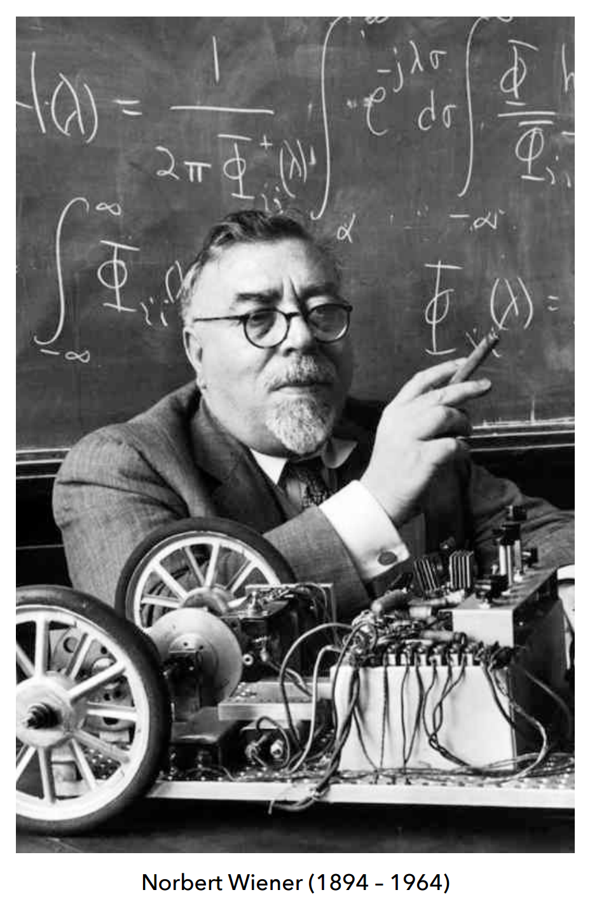
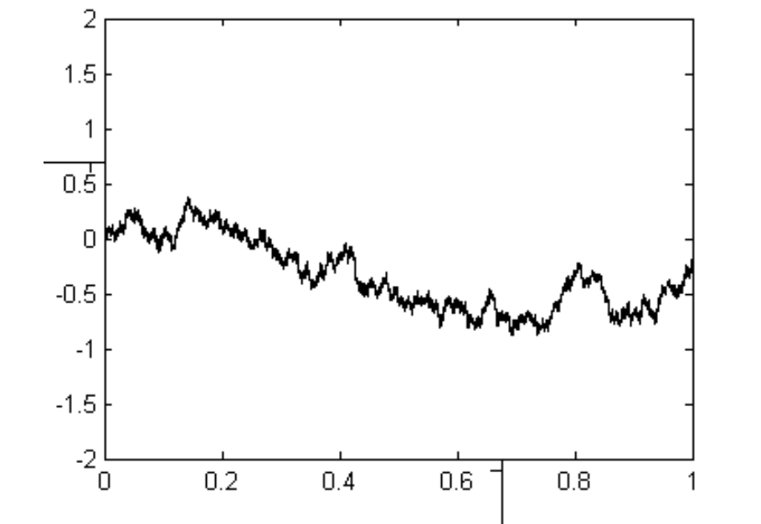
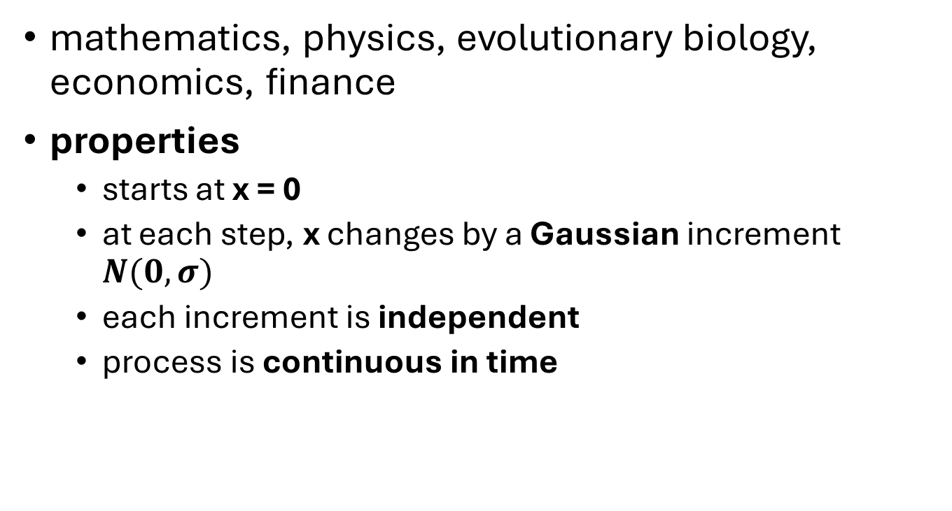
wiener diffusion process (1-D Brownian motion)
mathematics, physics, evolutionary biology, economics, finance
properties
starts at x = 0
at each step, x changes by a Gaussian increment $N(0,σ)$
each increment is independent
process is continuous in time

Slide 11
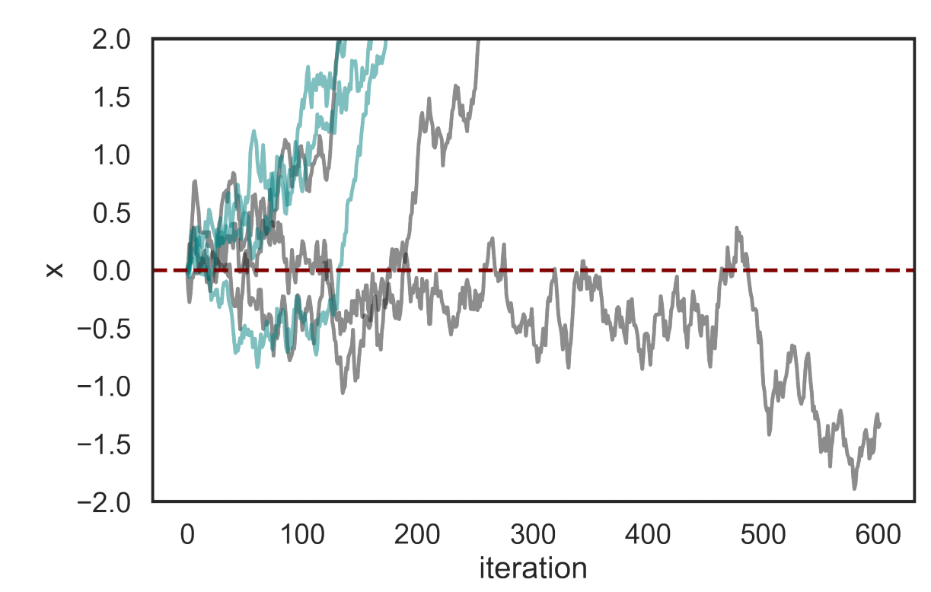
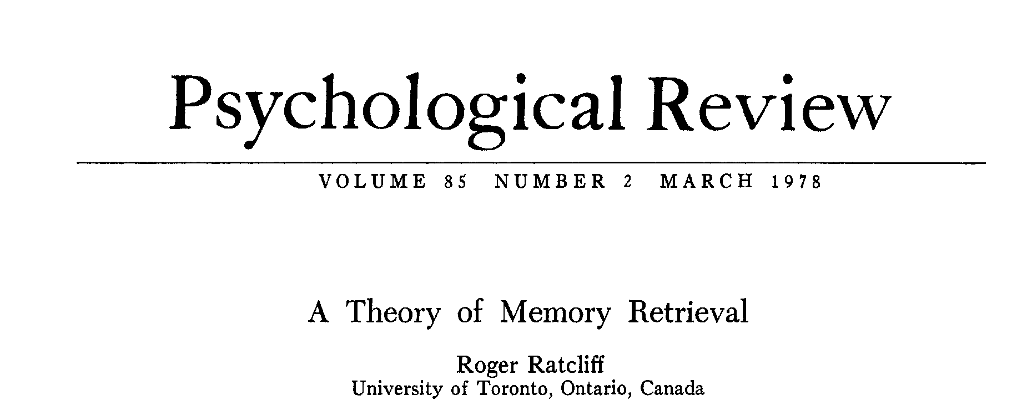
the diffusion decision model (DDM)
process terminates at fixed thresholds
process drifts towards positive or negative values
process can be biased a priori
constant non-decision time is added to total time to threshold
parameters can vary across trials

Slide 12
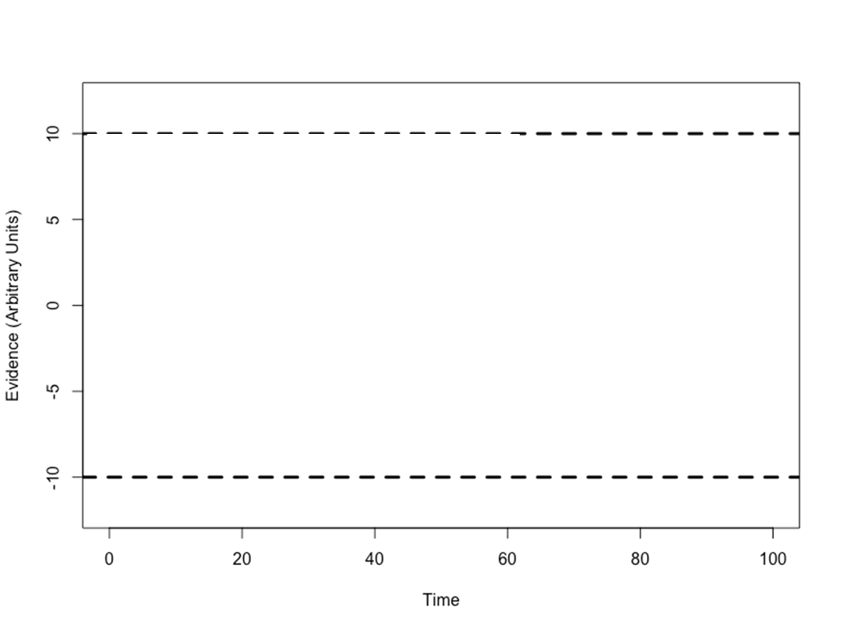
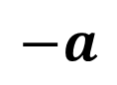
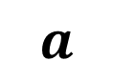
decision thresholds
h1: motion left
$$a$$
$$−a$$
h2: motion right

Slide 13
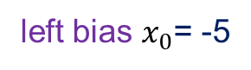
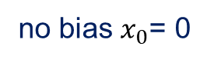
starting point
h1: motion left
$$a$$
left bias $x_{0}$= -5
no bias $x_{0}$= 0
$$−a$$
h2: motion right

Slide 14
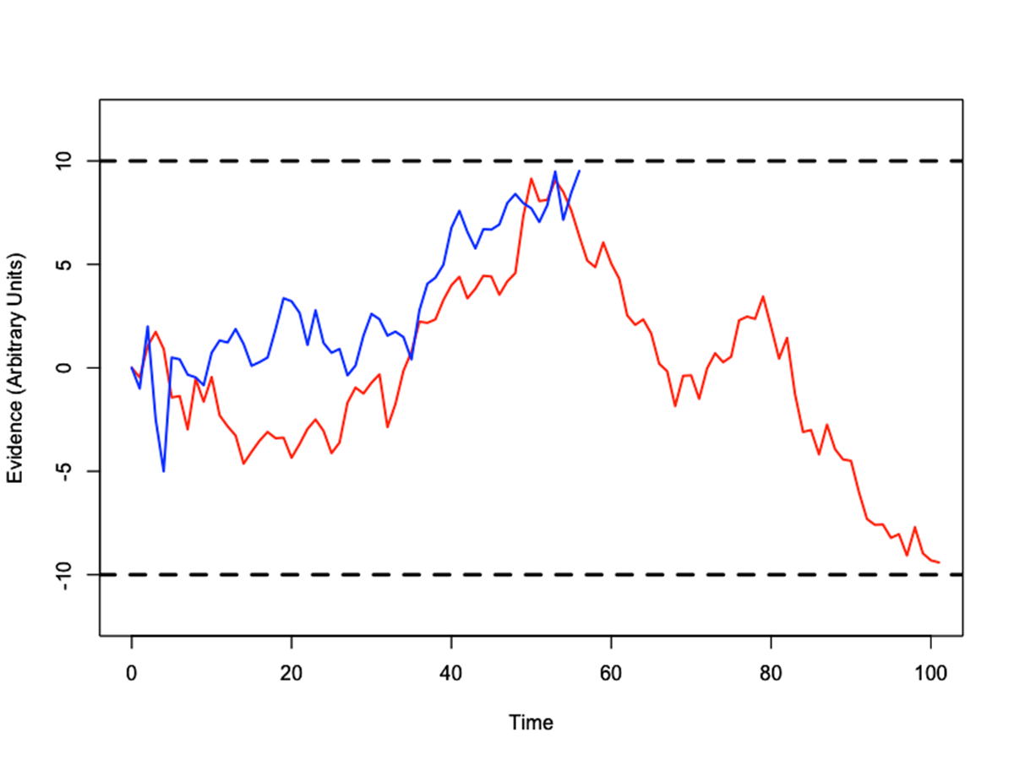
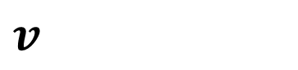
drift rate
h1: motion left
$$v$$
h2: motion right

Slide 15
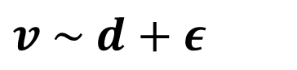
drift rate
h1: motion left
$$v \sim d+ε$$
h2: motion right

Slide 16
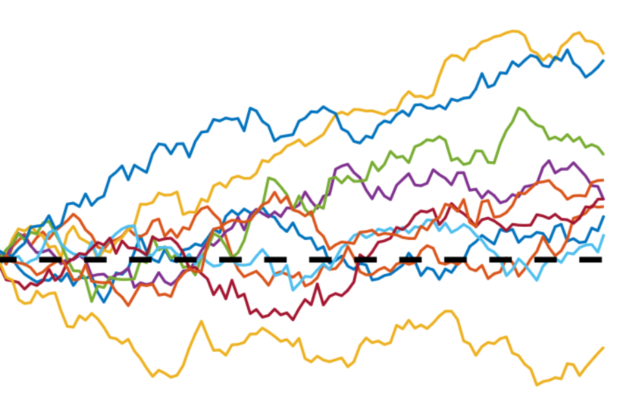
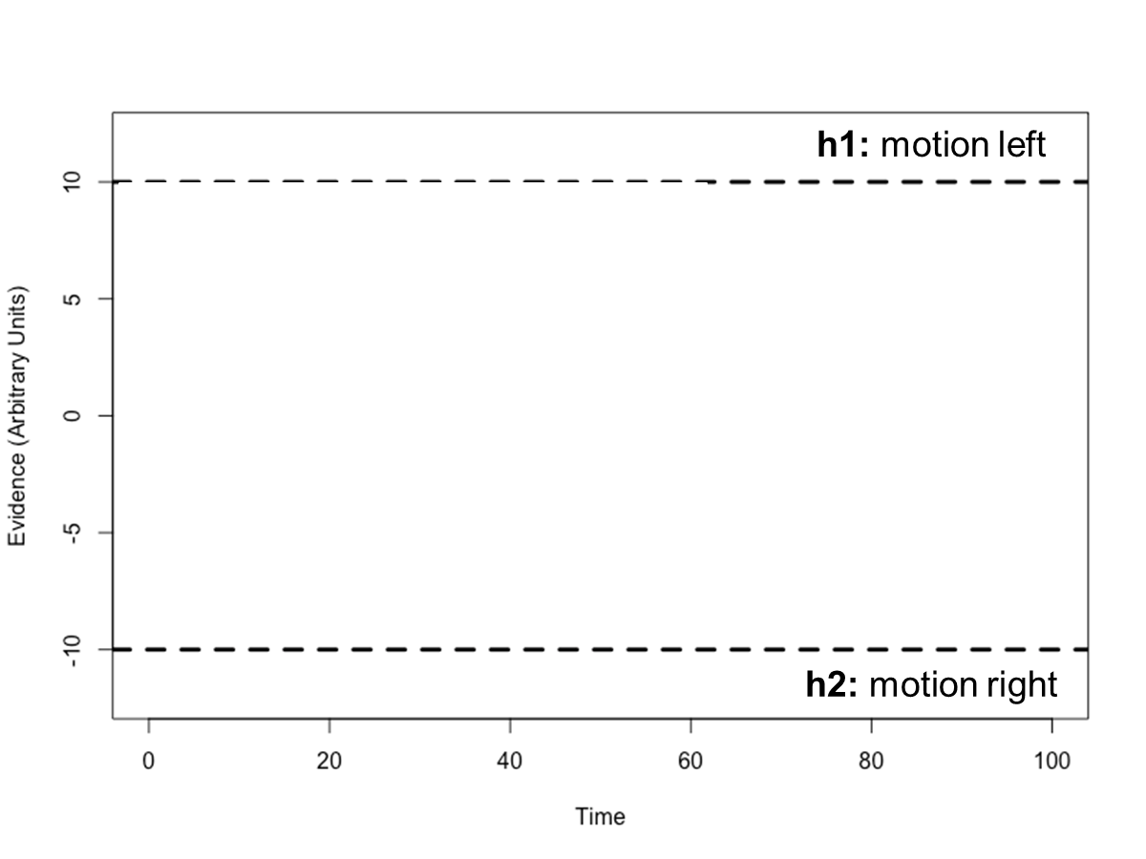
evidence contains both signal and noise
signal: on average, evidence points in the correct direction
noise: randomness in the stimulus and the brain
Over time, the accumulated evidence drifts (signal) and diffuses (noise) in the correct direction
Because noise is random, every trial has a different trajectory

Slide 17
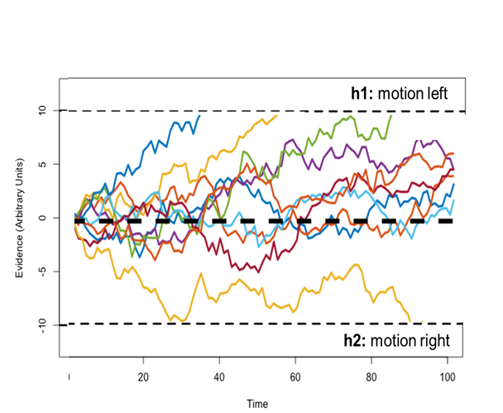
evidence contains both signal and noise
signal: on average, evidence points in the correct direction
noise: randomness in the stimulus and the brain
Over time, the accumulated evidence drifts (signal) and diffuses (noise) in the correct direction
Because noise is random, every trial has a different trajectory

Slide 18
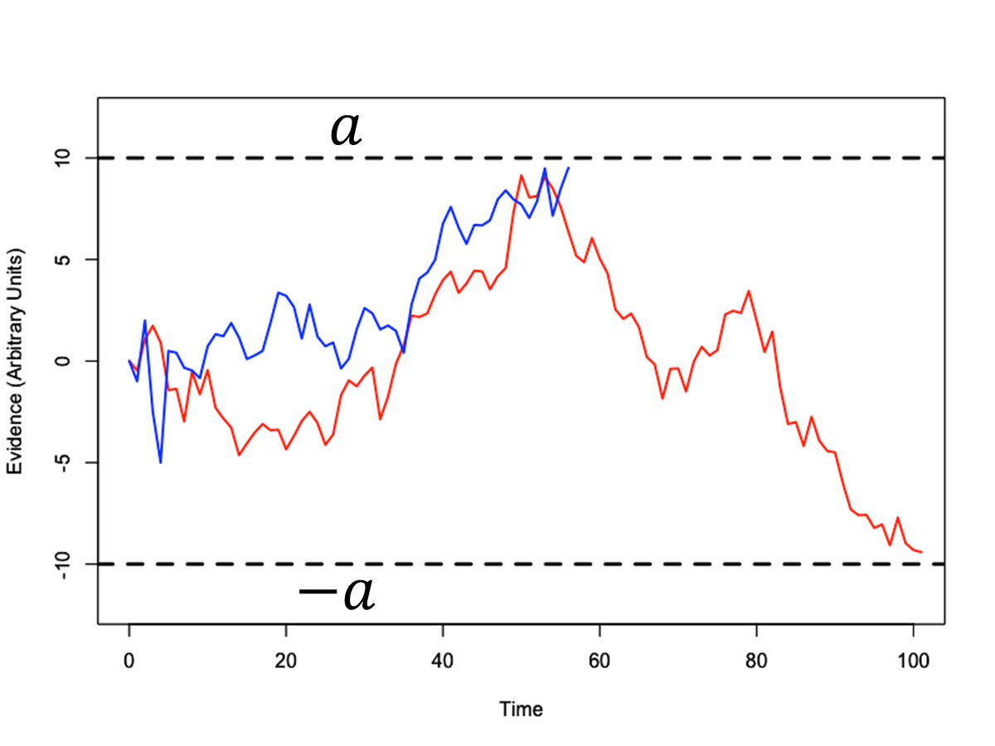
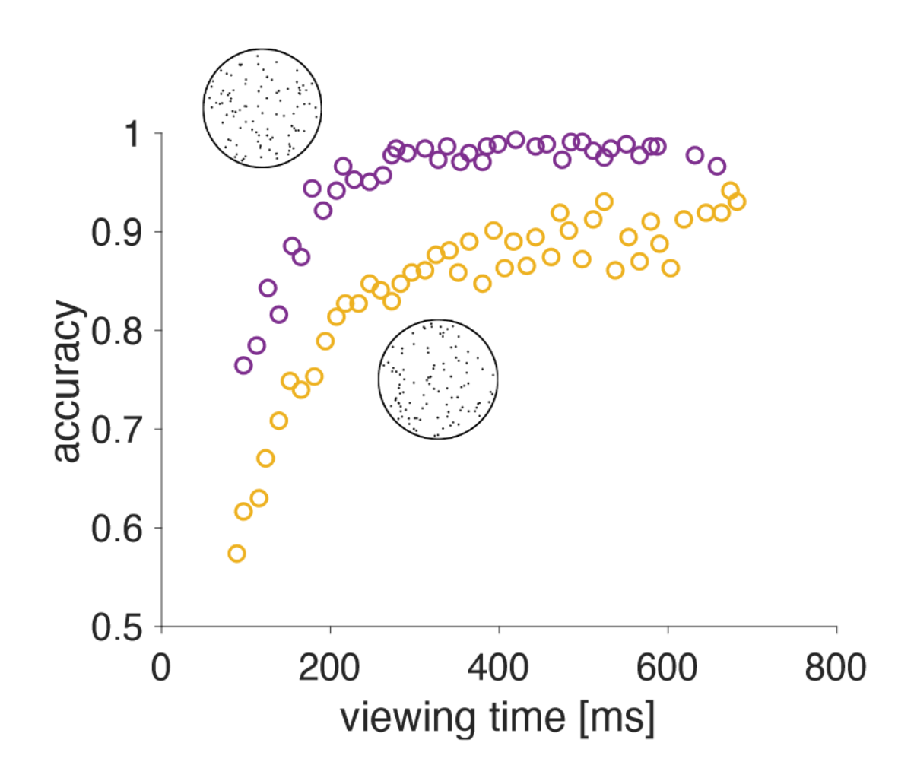
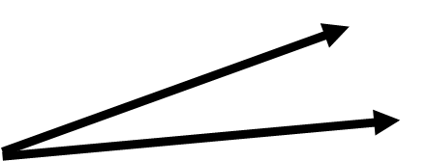
increasing coherence increases accuracy
h1: motion left
h2: motion right

Slide 19
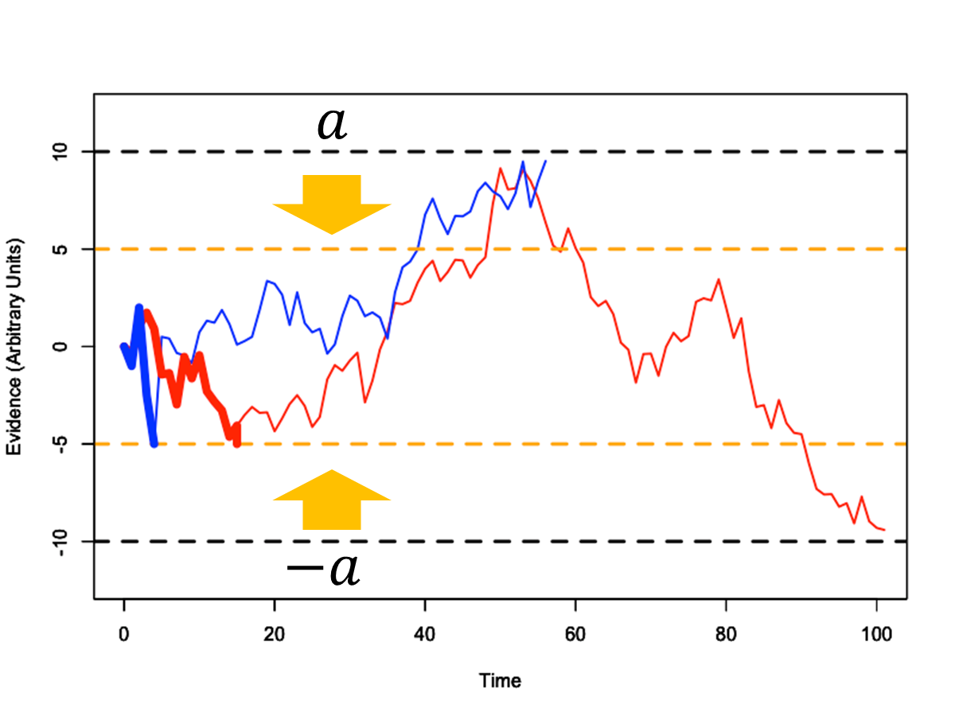
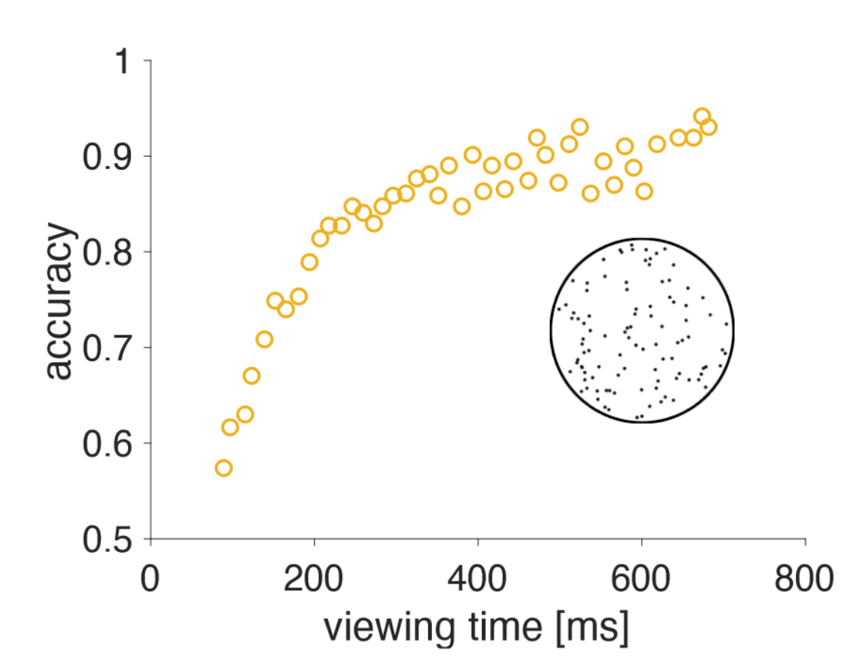
decreasing viewing time decreases accuracy
h1: motion left
h2: motion right

Slide 20

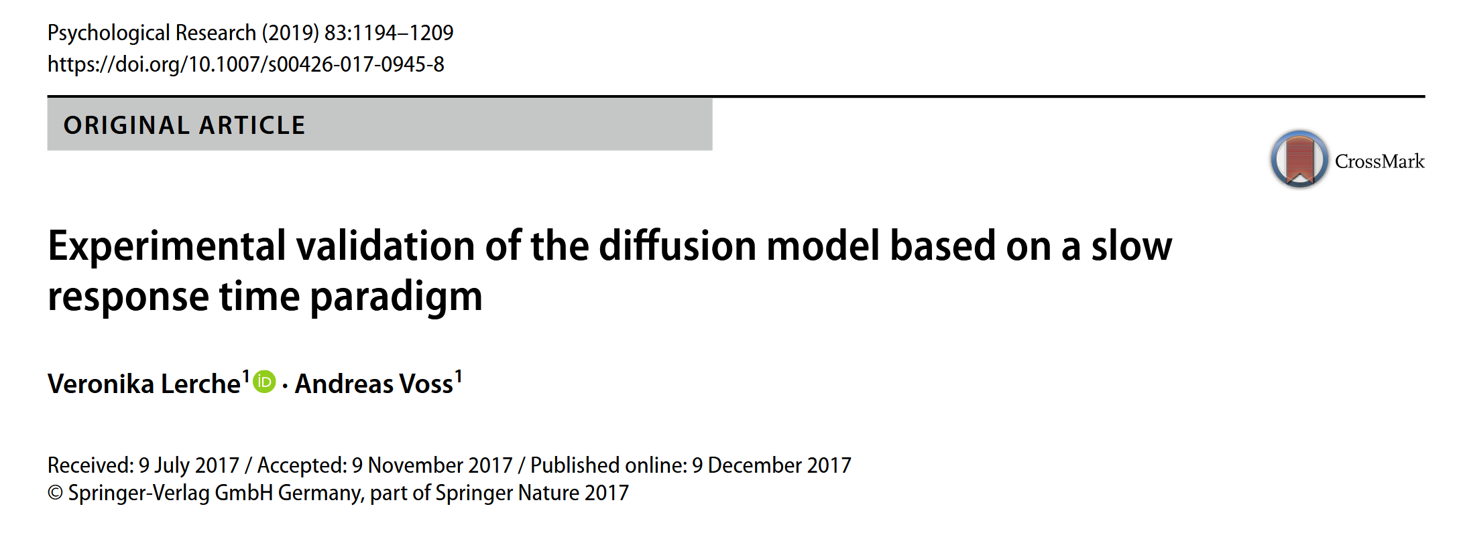
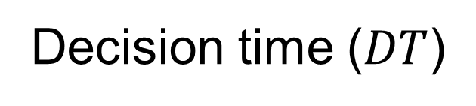
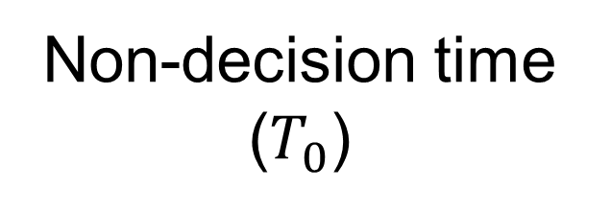
non-decision time
Decision time ($DT$)
Response time
Sensory delay
Motor delay
=
+
+
Non-decision time ($T_{0}$)

Slide 21
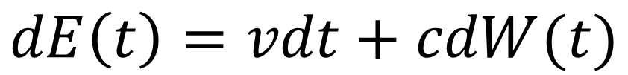
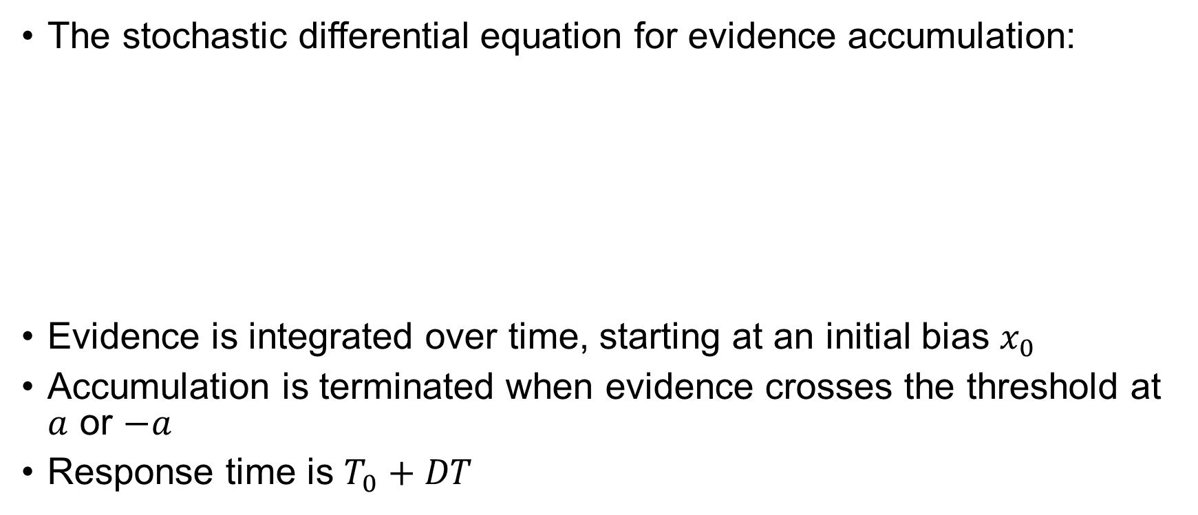
stochastic equation
The stochastic differential equation for evidence accumulation:
Evidence is integrated over time, starting at an initial bias $x_{0}$
Accumulation is terminated when evidence crosses the threshold at $a$ or $−a$
Response time is $T_{0}+DT$
Change in evidence at time t
drift
diffusion
$$dE\left(t\right)=vdt+cdW(t)$$
signal
noise

Slide 22
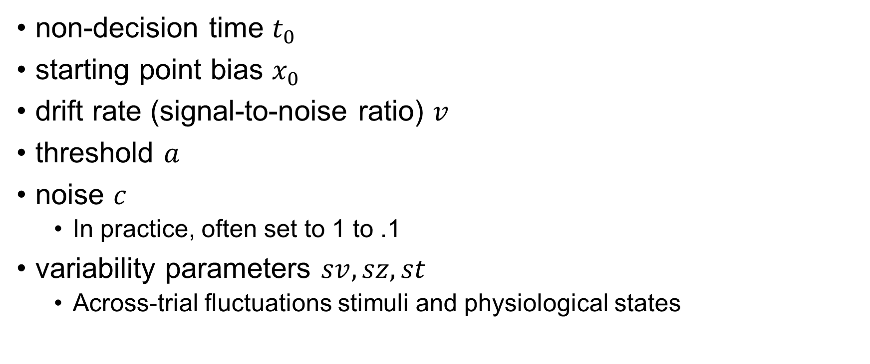
parameters
non-decision time $t_{0}$
starting point bias $x_{0}$
drift rate (signal-to-noise ratio) $v$
threshold $a$
noise $c$
In practice, often set to 1 to .1
variability parameters $sv, sz, st$
Across-trial fluctuations stimuli and physiological states

Slide 23
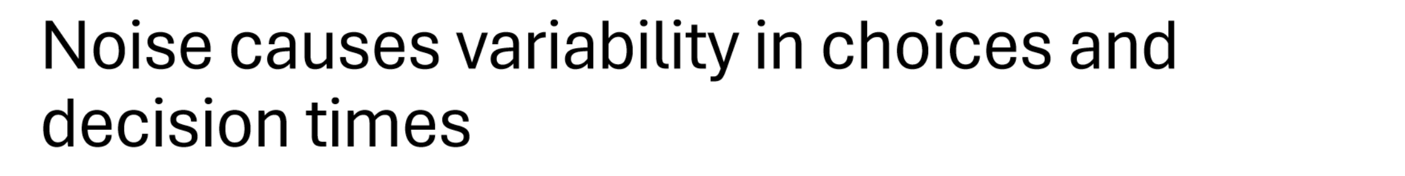
why variability parameters?

Slide 24
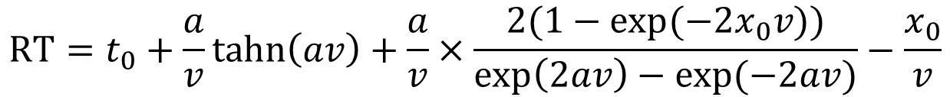
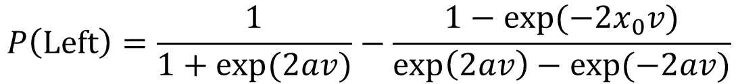
analytic expressions
$$P\left(Left\right)=\frac{1}{1+exp(2av)}−\frac{1−exp(−2x_{0}v)}{exp\left(2av\right)−exp(−2av)}$$
$$RT=t_{0}+\frac{a}{v}tahn\left(av\right)+\frac{a}{v}×\frac{2(1−exp(−2x_{0}v))}{exp\left(2av\right)−exp(−2av)}−\frac{x_{0}}{v}$$
Useful for visualizing results
Calculate the reward rate (reward per unit of time)
Equates to softmax equation for value-based choice

Slide 25
what have we learned so far?
what cognitive processes do the DDM parameters map onto?
threshold, drift rate, starting point, non-decision time
in what sorts of tasks would the DDM be a useful tool?

Slide 26
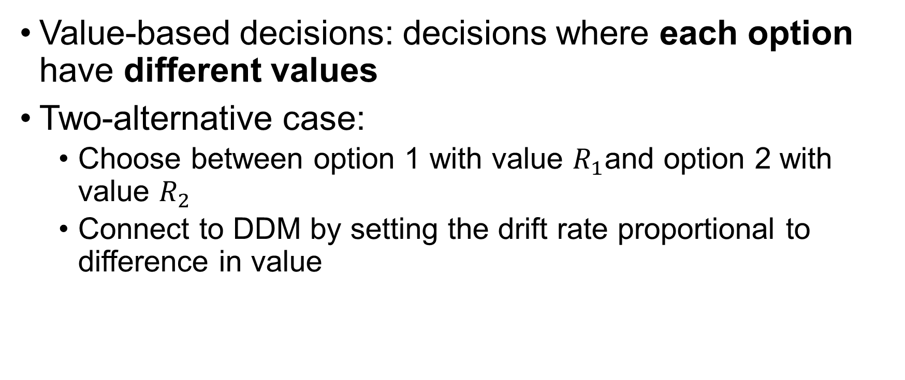
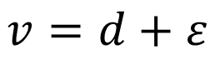
application to value-based decisions
Value-based decisions: decisions where each option have different values
Two-alternative case:
Choose between option 1 with value $R_{1}$and option 2 with value $R_{2}$
Connect to DDM by setting the drift rate proportional to difference in value
$$v=d\left(R_{1}−R_{2}\right)+ε=d∆R+ε$$
$$v=d+ε$$

Slide 27
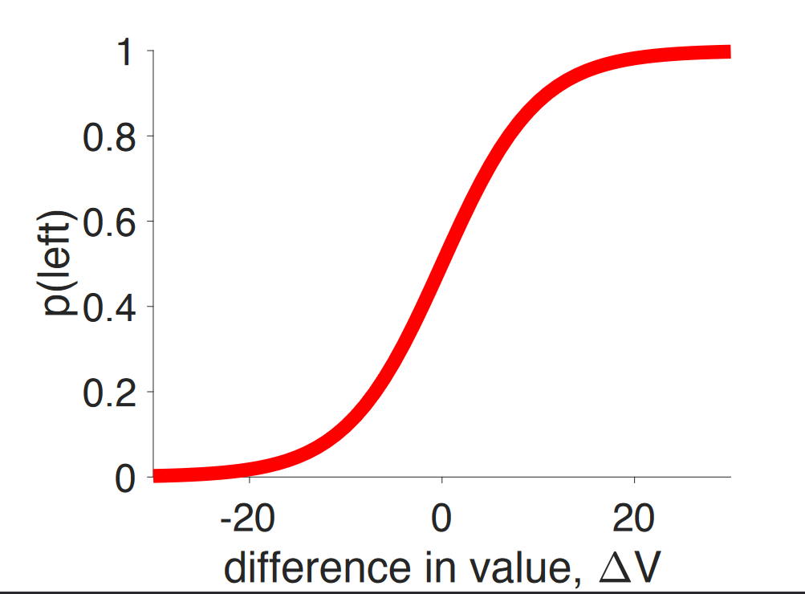
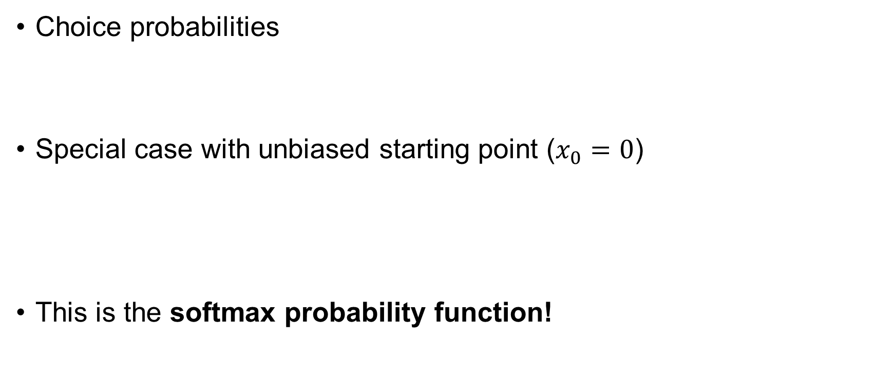


application to value-based decisions
Choice probabilities
Special case with unbiased starting point ($x_{0}=0$)
This is the softmax probability function!
$$p\left(left\right)=\frac{1}{1+\exp\left(2ad∆R\right)}−\frac{1−exp(−2x_{0}d∆R)}{exp\left(2ad∆R\right)−exp(−2ad∆R)}$$
$$p\left(left\right)=\frac{1}{1+\exp\left(2ad∆R\right)}$$
difference in value $∆R$

Slide 28
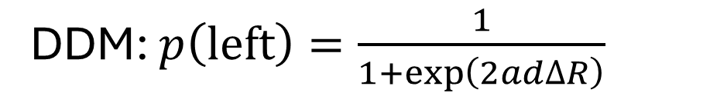
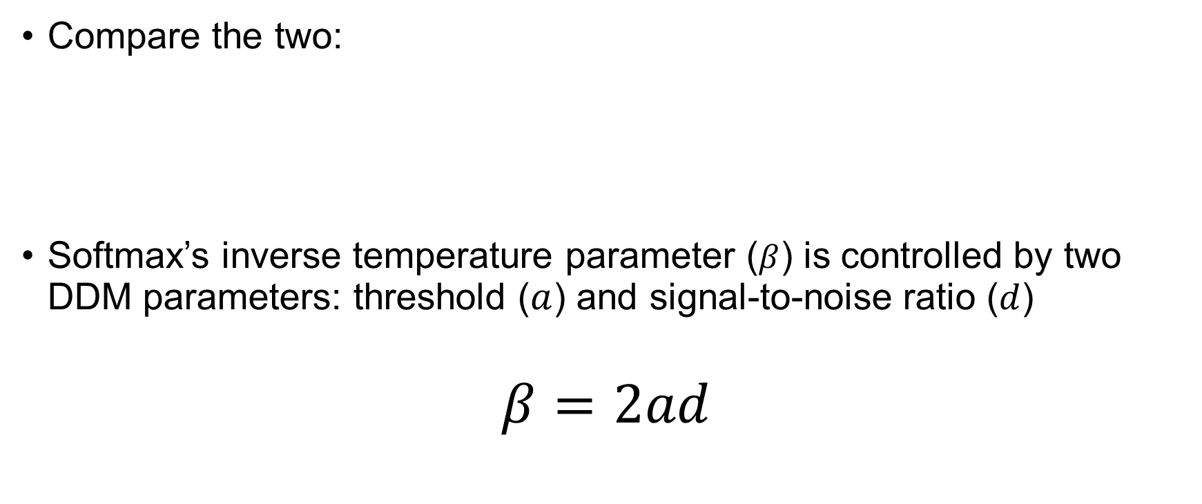
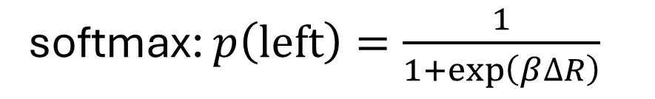
softmax :: DDM connection
Compare the two:
Softmax’s inverse temperature parameter ($β$) is controlled by two DDM parameters: threshold ($a$) and signal-to-noise ratio ($d$)
$$β=2ad$$
DDM: $p\left(left\right)=\frac{1}{1+\exp\left(2ad∆R\right)}$
softmax: $p\left(left\right)=\frac{1}{1+\exp\left(β∆R\right)}$

Slide 29
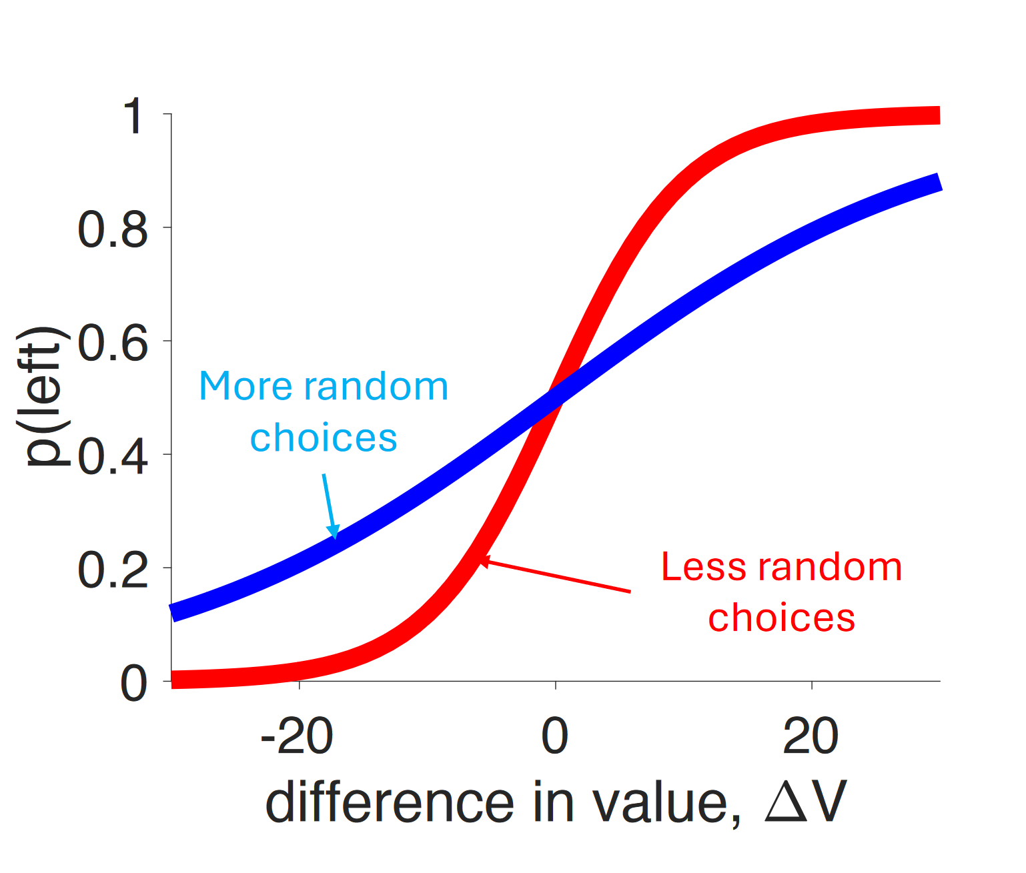
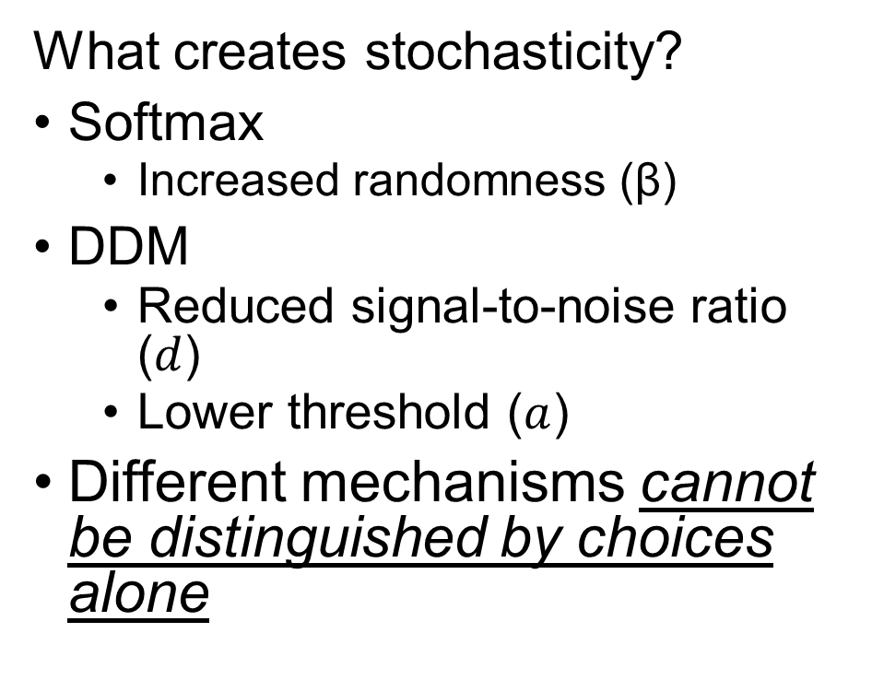

softmax :: DDM connection
What creates stochasticity?
Softmax
Increased randomness (β)
DDM
Reduced signal-to-noise ratio ($d$)
Lower threshold ($a$)
Different mechanisms cannot be distinguished by choices alone
difference in value $∆R$

Slide 30
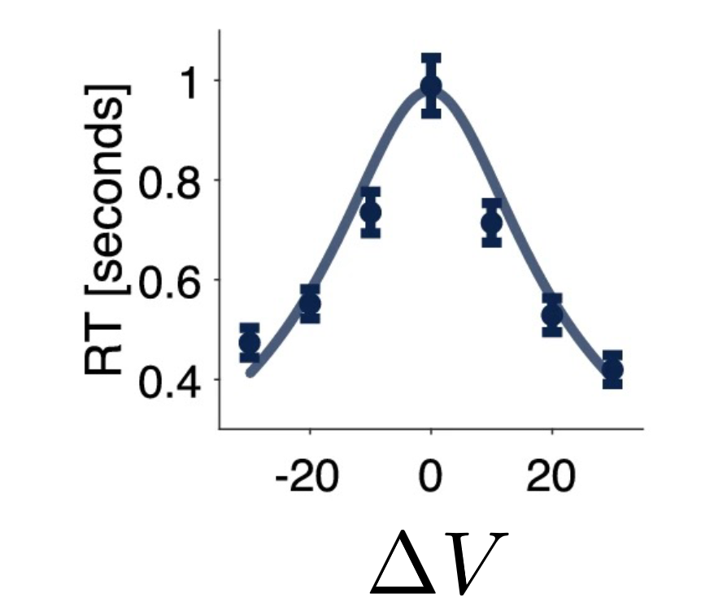
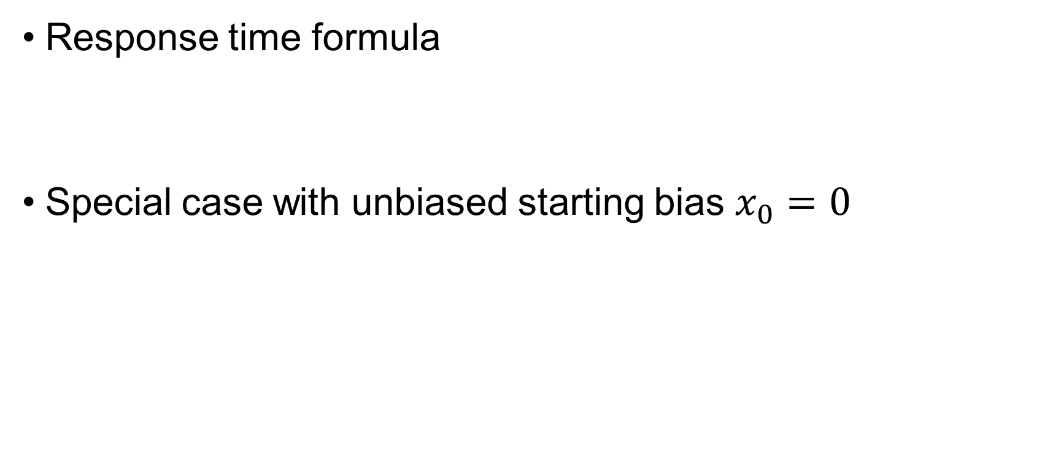


Response times in the value-based DDM
Response time formula
Special case with unbiased starting bias $x_{0}=0$
$$RT=t_{0}+\frac{a}{∆R}tahn\left(a∆R\right)+\frac{a}{∆R}×\frac{2(1−exp(−2x_{0}∆R))}{exp\left(2a∆R\right)−exp(−2a∆R)}−x_{0}∆R$$
$$RT=t_{0}+\frac{a}{∆R}tahn\left(a∆R\right)$$
$∆R$

Slide 31
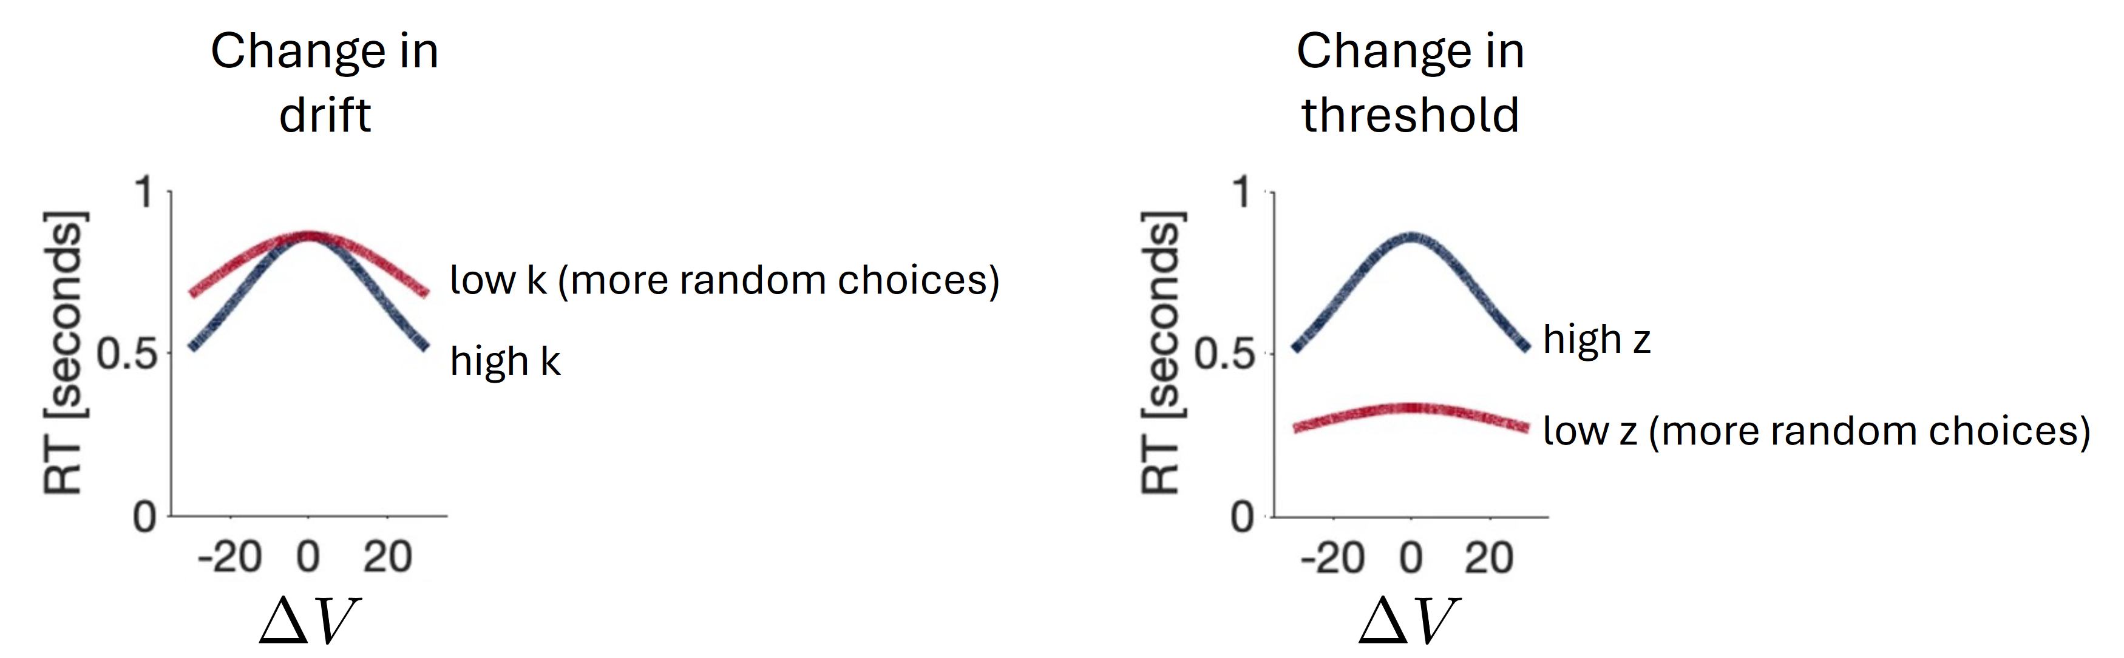




Response times in the value-based DDM
Changes to drift rate and threshold that induce stochasticity have opposite effects on response times
low $d$ (more random choices)
high $d$
high $a$
low $a$ (more random choices)
$∆V$
$∆R$

Slide 32

digression
$10
a) Did the agent fail to learn?
b) Did the agent respond noisily?

Slide 33



Slide 34


digression

Slide 35
Value-based DDM Summary
Drift rate is proportional to difference between options
Approximates softmax choice probabilities when initial bias is set to 0
Stochasticity in choice is influenced by two mechanisms
Drift rate
Threshold
These mechanisms can only be distinguished using response times

Slide 36
reflection
what did you already know?
what have you learned so far?
what is still confusing?

Slide 37
when can we use the DDM?
only two options
task involves relative evidence
there is perfect inhibition
there is no leakage of information
process is continuous in time
process is single-stage
otherwise: Leaky Competing Accumulator Model, Gaze-Weighted Accumulator Model, Linear Ballistic Accumulator Model, Piecewise Diffusion Model, Racing Diffusion Model, Circular Diffusion Model, etc.

Slide 38



Variations of the DDM

Slide 39




Variations of the DDM
Reinforcement learning
RLDDM (Fontanesi et al., 2019)
RLLBA (McDougle & Collins, 2021)
RLARDM (Miletic et al., 2021)
$$v=\frac{2v_{max}}{1+exp(m\left(Q_{correct}−Q_{incorrect}\right))})−v_{max}$$
$$v=m(Q_{correct}−Q_{incorrect})$$
$$v=mQ_{i}$$
$$v_{1}=V_{0}+w_{d}\left(Q_{1}−Q_{2}\right)+w_{s}\left(Q_{1}+Q_{2}\right)$$
$$v_{2}=V_{0}+w_{d}\left(Q_{2}−Q_{1}\right)+w_{s}\left(Q_{1}+Q_{2}\right)$$

Slide 40
essential bibliography
History of the DDM and theory on how the brain might implement it. Gold, J. I. & Shadlen, M. N. (2002). Banburismus and the Brain: Decoding the relationship between sensory stimuli, decisions, and reward. Neuron, 36(2), 299-308
Understanding the role of the different parameters and how to fit the DDM to behavioral data: Ratcliff, R., & McKoon, G. (2008). The diffusion decision model: theory and data for two-choice decision tasks. Neural computation, 20(4), 873-922.
Understanding the relationship between the DDM and neuropsychological data: Ratcliff, R., Smith, P. L., Brown, S. D., & McKoon, G. (2016). Diffusion Decision Model: Current Issues and History. Trends in cognitive sciences, 20(4), 260-281.

Slide 41
software for parameter estimation
Python
HDDM/HSSM
rlSSM
GLAMbox
PyDDM
R
RJAGS
RStan/BRMS
Julia
SequentialSamplingModels.jl

Slide 42
Hierarchical Bayesian Estimation
Models individual-level parameters within a group structure
Key components
Group-level parameters (hyperparameters): capture overall trends
Individual-level parameters: capture individual differences
Advantages
Combines individual- and group-level information to produce accurate estimates
Useful when data are sparse or noisy at individual level

Slide 43
JAGS (Just Another Gibbs Sampler)
JAGS is a software tool for Bayesian inference using Markov Chain Monte Carlo (MCMC) sampling
Why JAGS?
Flexible framework for Bayesian modeling
Can handle complex models and multiple distributions
Easy to use in R via runjags package

Slide 44
JAGS (Just Another Gibbs Sampler)
How it works:
Define the model in separate model file
Likelihood
Priors
Hierarchical structure
Run MCMC sampling
Initialize distributions
Burn-in samples
Sample from the posterior

Slide 45
Workflow overview
Step 1: Define the model
write model in JAGS syntax (specify likelihood, priors, hierarchical structure)

Slide 46
Workflow overview
Step 1: Define the model
Step 2: Load data in R
prepare dataset and ensure it is in a format that can easily be processed by JAGS (list format in R)

Slide 47
Workflow overview
Step 1: Define the model
Step 2: Load data in R
Step 3: Compile and run
use rjags to compile and run MCMC sampling

Slide 48
Workflow overview
Step 1: Define the model
Step 2: Load data in R
Step 3: Compile and run
Step 4: Assess convergence
use diagnostics such as trace plots, Gelman-Rubin statistic (R-hat), and effect sample size

Slide 49
Workflow overview
Step 1: Define the model
Step 2: Load data in R
Step 3: Compile and run
Step 4: Assess convergence
Step 5: Summarize posterior distributions
extract and summarize posterior estimates (e.g., means, credible intervals)

Slide 50
Workflow overview
Step 1: Define the model
Step 2: Load data in R
Step 3: Compile and run
Step 4: Assess convergence
Step 5: Summarize posterior distributions
Step 6: Interpret results
interpret the posterior distribution to make inferences

Slide 51
Workflow overview
Step 1: Define the model
Step 2: Load data in R
Step 3: Compile and run
Step 4: Assess convergence
Step 5: Summarize posterior distributions
Step 6: Interpret results
Step 7: Model comparisons
generate alternative model specifications and compare using model fit metrics (e.g., DIC, WAIC)

Slide 52
Workflow overview
Step 1: Define the model
Step 2: Load data in R
Step 3: Compile and run
Step 4: Assess convergence
Step 5: Summarize posterior distributions
Step 6: Interpret results
Step 7: Model comparisons
Step 8: Posterior predictive checks
simulate data and compare to empirical data

Slide 53
Workflow overview
Step 1: Define the model ***
Step 2: Load data in R ***
Step 3: Compile and run ***
Step 4: Assess convergence ***
Step 5: Summarize posterior distributions ***
Step 6: Interpret results ***
Step 7: Model comparisons
Step 8: Posterior predictive checks

Slide 54
DDM estimation with JAGS
Downloads
JAGS: https://sourceforge.net/projects/mcmc-jags/files/JAGS/4.x/
JAGS-WIENER: https://github.com/yeagle/jags-wiener
R-TOOLS: https://cran.r-project.org/bin/windows/Rtools/

Slide 55
Thank you!

